Slide 1


Using GraphQL APIs with Apollo client
Notes:
This lesson covers
Using Apollo Client in plain JavaScript and React
Understanding Apollo’s links and cache
Using Apollo’s hook functions for queries and mutations
Managing local app state with Apollo
Implementing and using GraphQL subscriptions over WebSockets
Shortly after GraphQL implementations started getting attention on GitHub, another class of GraphQL libraries began to attract notice as well: client libraries.
GraphQL client libraries are designed to manage communications between frontend applications and backend GraphQL services. A client library abstracts the tasks of asking a GraphQL service for data, instructing it to do mutations, and making its data responses available to the view layer of a frontend application.
Just as a GraphQL service can be thought of as an agent that does all the communication with your databases, a GraphQL client can be thought of as an agent that does all the communication with your GraphQL services.
Many GraphQL client libraries also have server components to enrich the server experience and support common frontend application requirements like caching, paginating through lists, and using real-time data.
Some GraphQL clients are designed to work with React exclusively. The most popular one in that category is Relay (relay.dev), which is primarily a Facebook project influenced by how Facebook uses GraphQL. Relay is the first client framework for GraphQL, and it shaped the evolution of the GraphQL language at Facebook.
Other GraphQL clients are designed for multiple view libraries with a primary focus on React. The most popular one in that category is Apollo Client (apollographql.com), which is part of a stack of GraphQL tools managed by Meteor Development Group.
There is also AWS Amplify (aws.amazon.com/amplify) by Amazon. It is a complete development platform that covers the entire development workflow of frontend applications.
These are just some of the top JavaScript projects that include a GraphQL client, but there are many more clients in JavaScript and many other languages. Check out az.dev/graphql-clients for a full list of all GraphQL client libraries.
GraphQL clients offer similar features with varying levels of complexity and customization. To explore an example of how to use a GraphQL client library with a GraphQL API, we will use Apollo Client simply because it’s the most popular client that supports multiple view libraries.

Slide 2

Table of Contents
Using Apollo Client with JavaScript
Using Apollo Client with React
Managing local app state
Implementing and using GraphQL subscriptions

Slide 3

Using Apollo Client with JavaScript
The first step to work with Apollo Client is to add it to the project dependencies.
It’s hosted under the npm package @apollo/client.
$ npm install @apollo/client
Notes:
Apollo Client can be used with React, Vue, Angular, and many others. It can also be used with plain JavaScript. Let’s start with an example of how to do that first; then we will see how to use it in the AZdev React project.

Slide 4
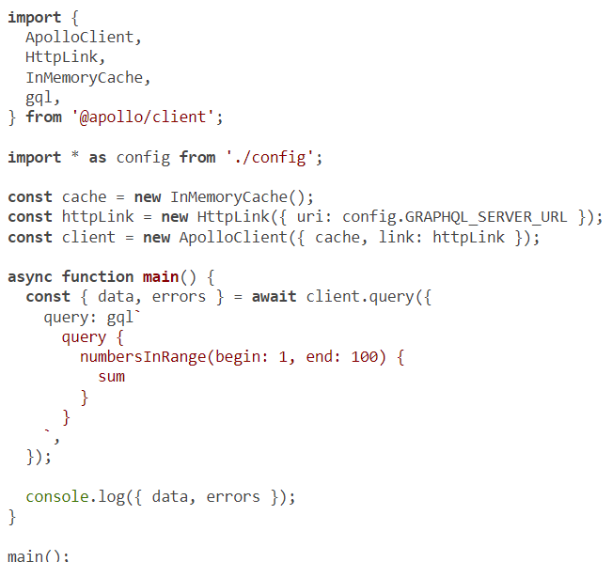
Making a query request
Notes:
Let’s start by looking at how to make a simple GraphQL query request using the Apollo Client query method (which is not React-specific).
NOTE
Listings 10.2-10.5 are temporary examples for testing. We’ll revert things back in listing 10.6.
Delete all the content in web/src/index.js, and replace it with the following.
This is the simplest example of using Apollo Client in plain JavaScript, but it introduces many new concepts. Let’s walk through them:
A client library like Apollo replaces any other Ajax library in your application. You don’t need “fetch” to make Ajax requests directly because the client makes all the requests internally. This is the primary task of every GraphQL client: they make all the Ajax requests for you and abstract the complexities of dealing with HTTP requests and responses.
The ApolloClient object is a constructor that can be used to initialize a client object per GraphQL service. An application might use multiple client instances to work with multiple GraphQL services. In this example, we have one httpLink object, and I initialized it using the same config.GRAPHQL_SERVER_ URL that we’ve been using so far.
In addition to the link attribute, Apollo Client requires the cache attribute. This attribute is used to specify the cache object that Apollo will use for its store. The default cache is an instance of the InMemoryCache object, which makes Apollo Client use the browser’s memory for caching. That’s what most web applications need to do. This cache flexibility allows an Apollo Client instance to be used with other types of cache. For example, if you need your application’s cached data to be persisted between sessions, you can use a cache object that works on top of window.localStorage.
Once you have a client object initialized and configured with a valid GraphQL service link attribute and caching strategy, you can use its API methods. The code in listing 10.2 uses the query method to send a GraphQL query operation and retrieve the server response for it. The query method takes an object whose query property is an object representing the GraphQL operation text to be sent.
Instead of using a string with the Apollo Client query method, we wrap that string with the gql tag function. You can use gql either as a template string tag (as we did in listing 10.2) or as a normal function call with the string as its argument. The gql function parses a GraphQL string into an abstract syntax tree (AST). It basically converts the string into a structured object. Strings are limited. Structured objects give GraphQL clients more control over GraphQL operations and make it easier for them to offer advanced features.

Slide 5
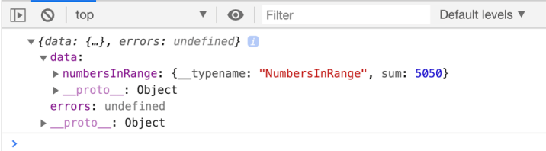
Using Apollo Client with JavaScript
Notes:
If everything works fine, you should see the console.log message in the browser’s console displaying the result of summing the numbers in the range 1-100

Slide 6
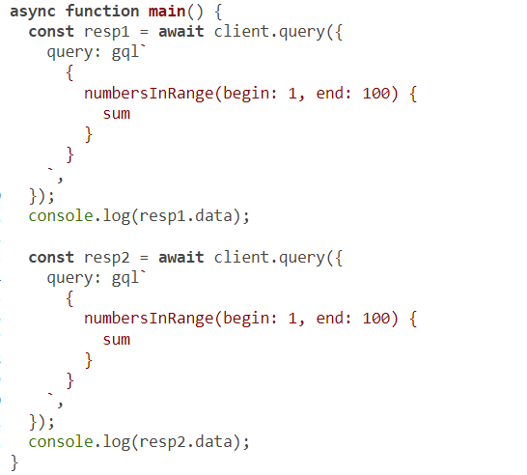
Making a query request
Notes:
At first glance, listing 10.2 is a lot of code to make a small request that can be done with a simple, direct Ajax call. However, this code comes with a huge win that we can see right away. Repeat the same query operation, and look at the Network tab in your browser when you refresh the session. Here’s an example to demonstrate.

Slide 7
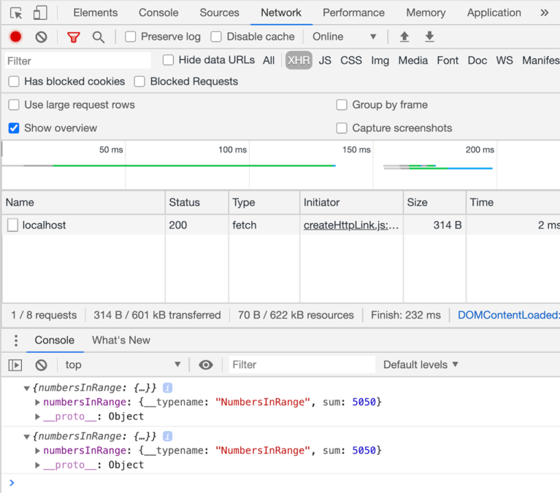
Making a query request
Notes:
Figure shows what you should see in the browser’s Network tab, filtered to show only XHR requests (XMLHttpRequest). Apollo Client issued only one Ajax request for both query operations because the response of the first request was automatically cached (in memory), and Apollo Client figured out that there is no need to ask the server again for data that we already have.

Slide 8
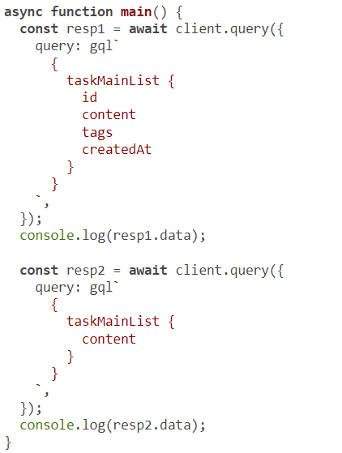
Making a query request
Notes:
Apollo Client does a lot of heavy lifting under the hood to make the cache as useful as it can be. For example, it caches every data response in a flattened data structure so that it can use the cache of individual objects to determine what future network requests are needed, even for different queries. For example, make the following changes in web/src/index.js.
This code asks to send two different query operations to the server.

Slide 9
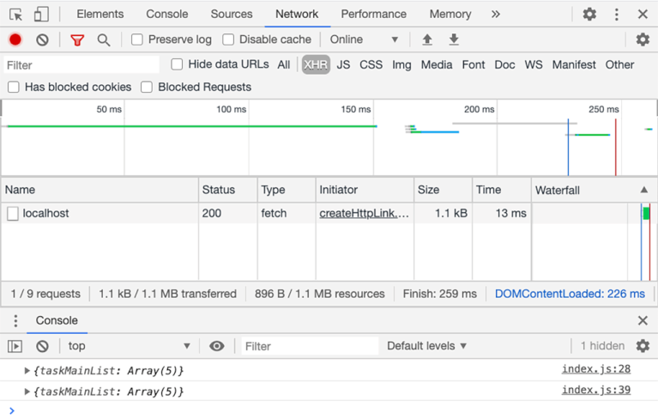
Making a query request
Notes:
However, because the second one is a subset of the first, Apollo Client will not go to the server a second time
While this is impressive, wait until you see the other features offered by Apollo Client (caching and more). Let me give you another example, but this time with a mutation operation.

Slide 10
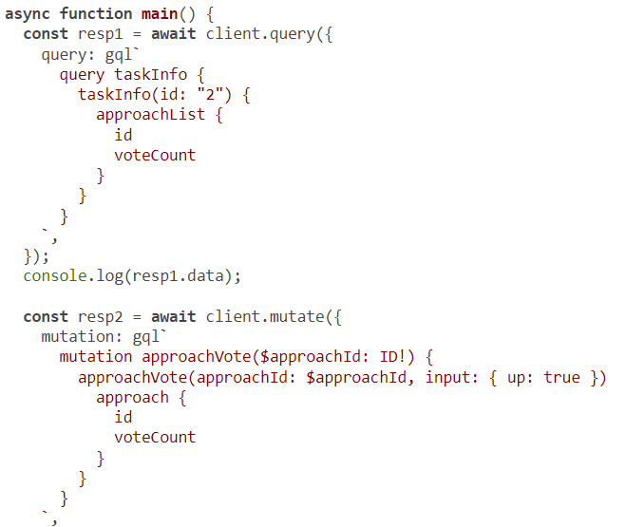
Making a mutation request
Notes:
To make a mutation request with Apollo Client, you use the .mutate method (instead of .query) and supply an object with a mutation property. If the operation to be sent uses variables, you can supply a variables property to specify their values.
The following is an example of sending the mutation operation to vote on Approach 2. I’ve also included a query to fetch the voteCount field for Approach 2 (which is under Task 2) before and after the mutation to verify that it worked.

Slide 11
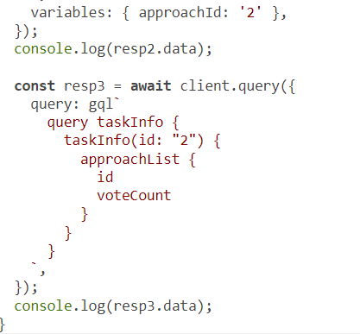
Continued code
Notes:
The first query request should show that Approach 2 has 0 votes. The second request updates that vote count to 1, and the third verifies that Approach 2 now has 1 vote.
Note that Apollo Client included the introspective __typename field in all three operations, although we did not specify it (see figure). How did it do that? And, more important, why did it do that?
That’s one other reason we’re wrapping all operations with gql. Since the requests are represented as objects, Apollo Client can inspect these objects and easily modify them to, for example, include the __typename field.

Slide 12
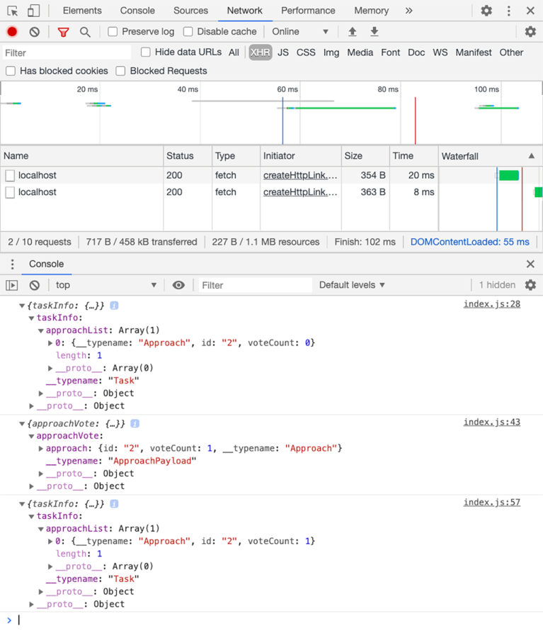
Making a mutation request
Notes:
To understand why Apollo Client did that, take a good look at your Network tab (or mine, in figure), and note that Apollo Client made only two network requests. It did not issue a network request for the third query operation because that operation did not ask for anything new. The mutation operation already informed Apollo Client that the new voteCount is 1, so it cached that number. Since it asked for the __typename as well, it can use a combination of __typename and id to uniquely identify each object it sees on a global level. It did exactly that for Approach 2. It used the Approach’s globally unique ID (Approach:2) to determine that we already know the object’s id and voteCount.
That’s impressive. We did nothing special to make this powerful feature work. We’re just issuing the same simple queries and mutations, and Apollo Client is intelligently making the cache work seamlessly for them.
The rest of this lesson demonstrates how Apollo Client can be used with React and shows the powerful features it offers for React applications. First, instead of the manual Ajax requests we’ve been doing so far without a client, we will use Apollo’s query and mutate methods. Then we will explore how to invoke these mutations with Apollo’s React-specific methods.

Slide 13
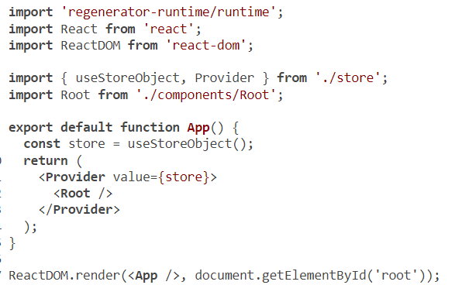
Making a mutation request
Notes:
You can now revert all the test changes made so far in web/src/index.js and put back the original code.

Slide 14
Table of Contents
Using Apollo Client with JavaScript
Using Apollo Client with React
Managing local app state
Implementing and using GraphQL subscriptions

Slide 15

Using Apollo Client with React
import React, { useState } from 'react';
import fetch from 'cross-fetch';
import * as config from './config';
import {
ApolloClient,
HttpLink,
InMemoryCache,
} from '@apollo/client';
const httpLink = new HttpLink({ uri: config.GRAPHQL_SERVER_URL });
const cache = new InMemoryCache();
const client = new ApolloClient({ link: httpLink, cache });
// ·-·-·
Notes:
To use Apollo Client with React, we first need to initialize it (just as we did in listing 10.2). A good place to do so for this application is in web/src/store.js, where we have been managing the local app state so far.

Slide 16
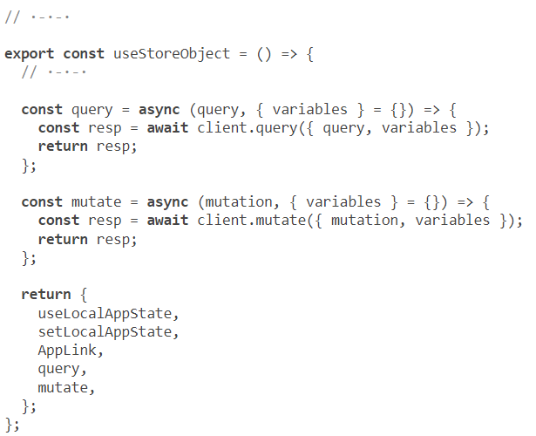
Using the query and mutate methods directly
Notes:
Now, instead of the fetch-based request method that is exported in the store’s context object, we need to introduce two new methods: one for queries and one for mutations. To keep the changes in the app to a minimum, we will start by having the exact same function signature as the good-old request function. The new methods will just be wrappers around Apollo Client’s methods.
TIP
You can remove the request method. We no longer need that dependency.
Note that I kept these new methods within the useStoreObject function because we still need to include the authToken header, which is part of the user state object (which is managed by the store). Later in this lesson, we will see how Apollo Client can replace the entire local app state store.
Now, for every call to the old request function in all components, we have to do the following:
Add an import { gql } from '@apollo/client' statement.
Wrap the query or mutation text with gql.
Instead of request, destructure query or mutate out of useStore.
Replace the request method with query if the operation is a query or mutate if the operation is a mutation.

Slide 17
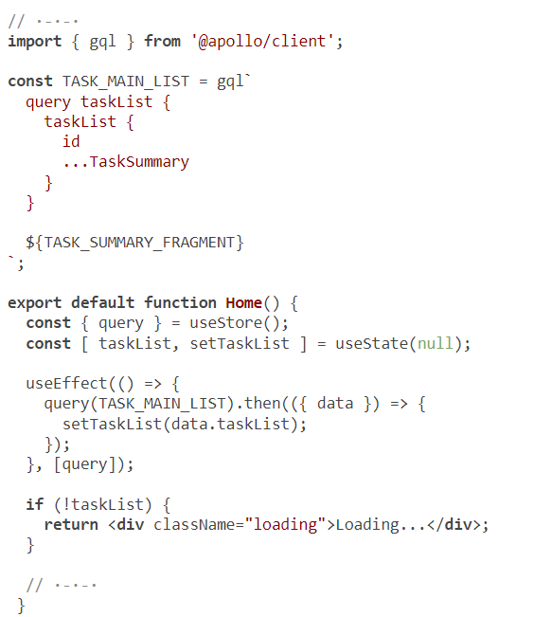

Using the query and mutate methods directly
Notes:
For example, in web/src/components/Home.js, here are the changes we have to make.

Slide 18
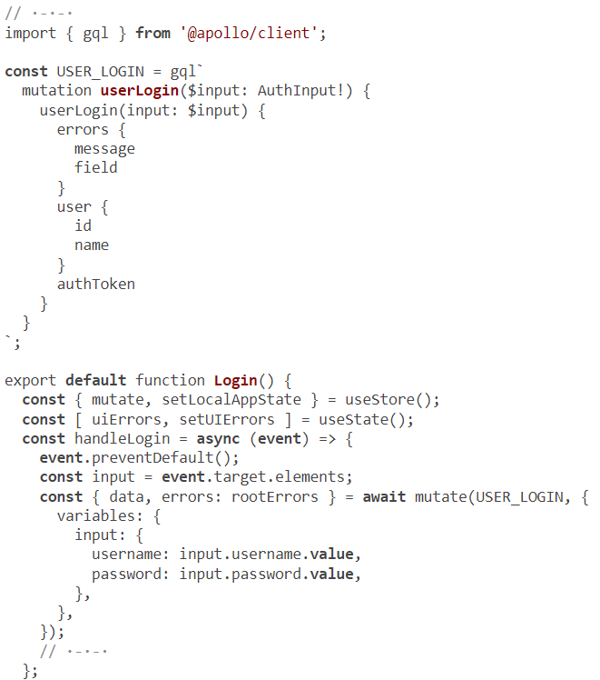
Using the query and mutate methods directly
Notes:
Here’s an example of how to replace the request call for a mutation operation. In web/src/components/Login.js, the changes to make are as follows.
That’s it on the simplest level. You can now test the home page and the login form. GraphQL operations will be done through Apollo Client instead of the previous fetch-based request method.
NOTE
Everything else would error out for you if you removed the old request method.
Go ahead and change all the other components to use query/mutate instead of request. Look for request( in your code editor to find all the components that need to be changed. Some operations will not work correctly because the new query/ mutate methods do not include the current user’s authToken yet. We’ll fix that next.
The Git branch 10.2 has all these changes. All GraphQL operations are done with the new query/mutate methods.
CURRENT CODE
Use git checkout 10.2 to reset your local repo to the current progress in the code.
Did you notice that the changes we made in the components were minimal? We just wrapped operation texts with gql and replaced a method with another one. That’s the power of having good abstractions.
What we have done so far is a basic use of Apollo Client in a React application, but it’s already paying off. The home page data is now cached after the first hit. If you navigate to a Task page and then back to the home page, Apollo Client will not issue another network request for the taskList.

Slide 19
Including authentication headers
To make the current user’s authToken value part of the link chain context, start by installing the new package.
$ npm install @apollo/link-context
Notes:
While caching is great, it introduces some challenges that we need to learn about. Test the search form right now. Since we’re no longer including the authToken in all requests, the search operation will not work correctly for private Task entries. As an example, test searching for “babel” after you log in with test/123456. That user owns the sample data Task record about Babel, but the search field is not currently returning it. We need to include the current authToken value in the headers of GraphQL requests to fix that.
However, now that we’re making the Ajax request through Apollo Client, we don’t have direct control over what headers to send. We need to do the request through Apollo Client methods and flow. We can do Ajax requests through the @apollo/ link-context package, which can be used to change the context of the GraphQL operations issued by Apollo Client. We just create a new link object and make it part of Apollo Client’s link chain.

Slide 20
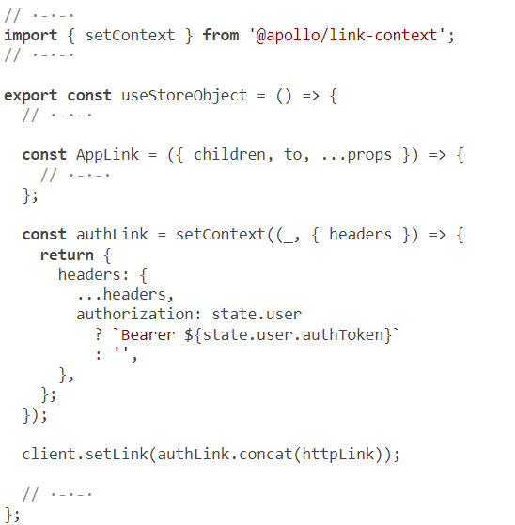
Including authentication headers
Notes:
Change web/src/store.js as follows to make the new link part of the chain for Apollo Client.
Note that I placed the new authLink in the useStoreObject app so that it can use JavaScript closures to access the state.user object (which is stored on the React context object). Now, if you search for “babel” while logged in as the “test” user, it should work.
TIP
If the search for “babel” does not work, try restarting your web server to clear any previous cache

Slide 21
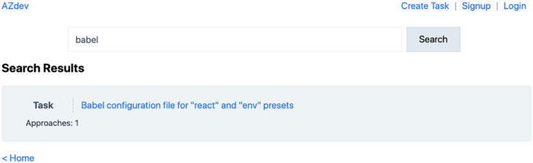
Including authentication headers
Notes:
There is a problem. To see it in action, test this flow without refreshing the browser:
Log in with test/123456.
Search for “babel” (which should work).
Log out.
Search for “babel” again (which should not work).
You’ll notice that the second public search returns the private Babel Task entry
This is happening because of Apollo Client caching. The search for “babel” was cached when the owner was logged in, and it remained cached when the owner logged out.
This is a common challenge when dealing with caching. The application logic often needs to manually reset the cache.

Slide 22
Including authentication headers
const setLocalAppState = (newState) => {
if (newState.component) {
newState.component.props = newState.component.props ?? {};
}
setState((currentState) => {
return { ...currentState, ...newState };
});
// Reset cache when users login/logout
if (newState.user || newState.user === null) {
client.resetStore();
}
};
Notes:
Apollo Client provides many methods to work with the cache. You can reset the cache in part or in whole, and you can do that either directly after operations (for example, right after the USER_LOGIN mutation) or globally when the state of your application changes. Let’s do the latter. Let’s reset the entire stored cache when the user logs in or out. We can do that in the setLocalAppState context method (which is the one this code uses to make updates to the local app state).

Slide 23
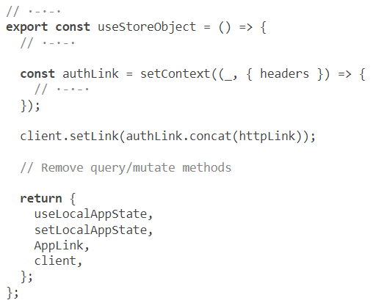

Using Apollo hook functions
Notes:
While we have a working solution to make all GraphQL communications through Apollo Client, this is not the ideal way to use it. We are simply not utilizing a big part of the power Apollo Client offers.
Apollo Client offers React hook functions to simplify the logic of view components. The two most common Apollo hook functions are useQuery and useMutation, and they are the primary way of using Apollo Client with React. In fact, if we change the code to use them, we will not need the query/mutate methods that we have so far.
To be able to use these hook functions in components, we have to wrap the components tree with a provider component. The provider component concept is simple: you supply a provider component with an object, and it makes that object available to all the children components in the components tree it wraps.
Inspect the code in web/src/index.js, and see how it uses a Provider component to make the global store available in children components. Components do not generally use the store object directly but rather methods that have access to it (through React’s context). Examples of such methods in the current store are useLocalAppState, setLocalAppState, and AppLink.
Apollo Client’s provider component works in a similar way. You make the client instance (which is becoming our new app state store) the provided context value. Children components can then use the hook functions (like useQuery) to access and modify Apollo Client’s state (the cache).
React supports having multiple provider wrappers (that provide different contexts). To make the changes minimal for this first step of using Apollo hooks, let’s wrap the components tree as is with the Apollo provider component.
First, let’s remove the query and mutate methods from the store and expose the client instance object instead.

Slide 24
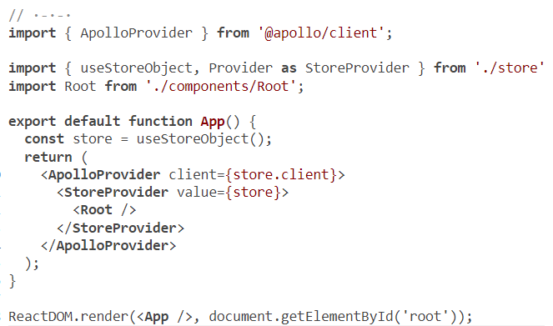
Using Apollo hook functions
Notes:
NOTE
Remember, the Apollo Client object still has to be bound to the current local app state store (to access the user state and include the current authToken value). Later in this lesson, we will see how to manage the app state through Apollo Client itself to simplify the code and use only one global context object.
Apollo exports the ApolloProvider component that can be used to make the client instance available to all children components. Here are the changes in web/src/index.js to define and use ApolloProvider.
Note that I renamed the previous Provider component StoreProvider because it’s no longer “the” provider. More-specific names are better.

Slide 25
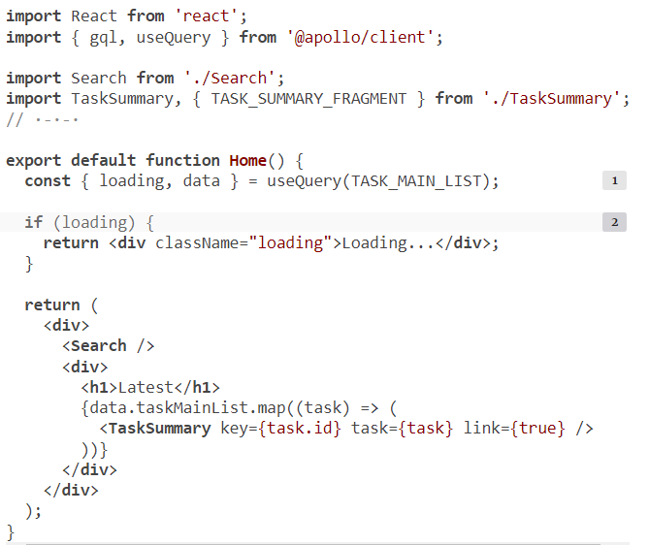
Using Apollo hook functions
Notes:
With the client instance object available to all components, we can now use Apollo hooks everywhere in the components tree. Let’s start with the Home component.
Here are the changes that I made to that component to make it use the useQuery hook function.

Slide 26

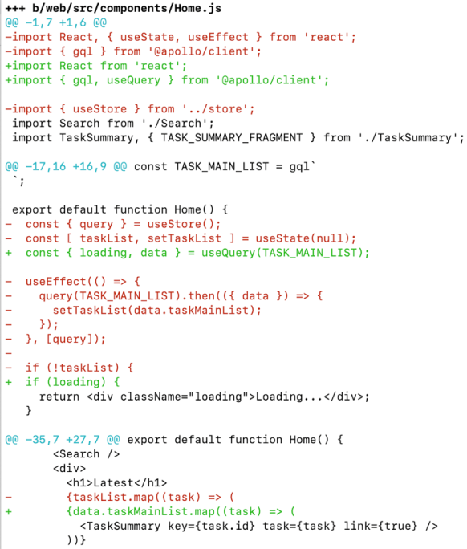
Using Apollo hook functions
Notes:
How simple and nice is that? Look at the output of git diff on this change to see what we’re able to replace
The simple useQuery hook function enabled us to replace the useState and useEffect React hook functions, which were previously used to manually do the data fetching and manage the request status. This is now all done internally in Apollo Client.

Slide 27
Using Apollo hook functions
export default function Home() {
const { error, loading, data } = useQuery(TASK_MAIN_LIST);
if (error) {
return <div className="error">{error.message}</div>
}
if (loading) {
return <div className="loading">Loading...</div>;
}
// ·-·-·
}
Notes:
The loading variable is a Boolean value that Apollo sets to true while the network data request is pending. useQuery also returns an error variable, which holds any GraphQL root errors or network errors. Your UIs should always handle both the loading and error states. For example, we can add another if statement and render an error message when the error variable has a value.
TIP
When it comes to handling errors in the UI, you should try to make the error branch as close as possible to the data associated with it. For example, the if statement I added in listing 10.17 blocks the entire home page, including the search box. The search box has nothing to do with any possible errors in the TASK_MAIN_LIST query. Try to fix that as an exercise.
This change in the Home component was straightforward because the replaced code was a common task that components do. We’ll soon see examples of less common things to do with Apollo; but first, let’s look at how to do a mutation with the useMutation hook function.
The useMutation hook function is similar to useQuery, but it does not send the operation right away. It returns a two-item tuple, where the first item is a function that sends the mutation operation when invoked. The second item is the mutation result (after the function is invoked).

Slide 28

Using Apollo hook functions
Here’s an example of how we can use both items in the returned tuple.
const [ loginUser, { error, loading, data } ] = useMutation(USER_LOGIN);
Notes:
The loginUser function makes the network request when it’s invoked, and it returns the GraphQL response object. For example, we can do the following to invoke loginUser and read the data/errors properties of its GraphQL response object.
const { data, errors } = await loginUser({
variables: ·-·-·
});

Slide 29
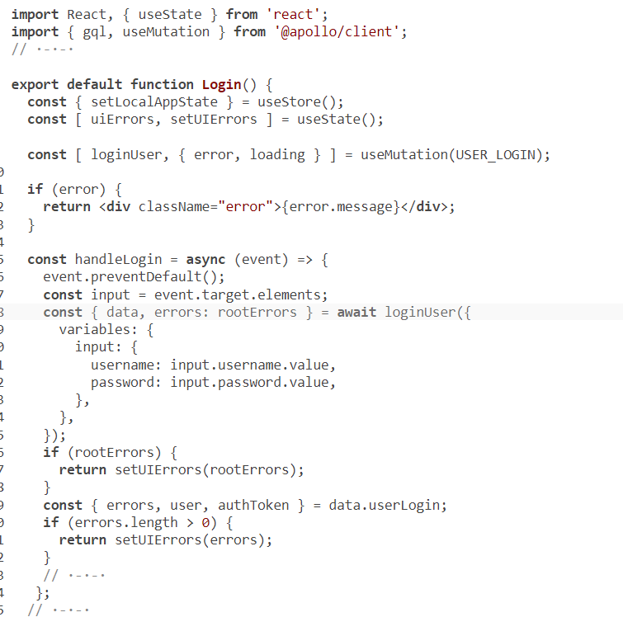
Using Apollo hook functions
Notes:
Here are the changes I made to web/src/components/Login.js to make it send its mutation operation with the useMutation hook function.
Note that the changes are minimal here because the Login component does not have UI state after the mutation is successful (it simply gets unmounted).
WHAT TO DO WITH THE LOADING STATE
You should change your UIs to indicate that a request is pending. For query operations, this can be as simple as displaying a loading indicator where the data will appear. For mutations, you should at least disable the Submit button (to prevent making multiple operations with multiple clicks). I usually also make the button show a loading indicator in its label.

Slide 30
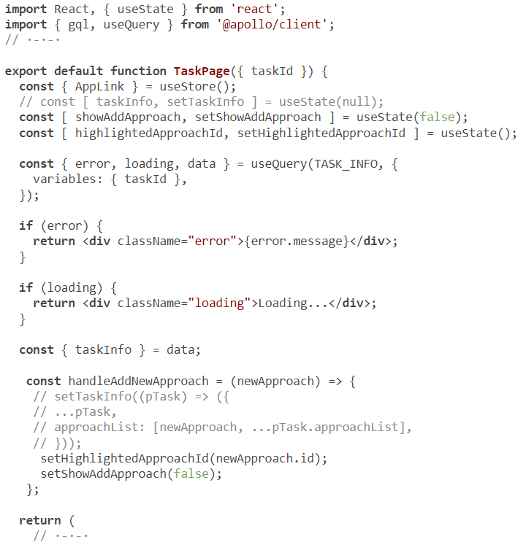
Using Apollo hook functions
Notes:
It’s now time for you to get comfortable with useQuery and useMutation. Convert the TaskPage component next. This component currently has three useState calls and one useEffect. Introducing the useQuery method can get rid of the useEffect call and one of the three useState calls. Give it a try. Here’s what I ended up doing.
The remaining useState objects (showAddApproach and highlightedApproachId) manage state elements that are local to this component. Apollo usually is not used for this type of local component state. However, we will soon see how Apollo can help us get rid of the useStore call.
NOTE
I commented out the part that handles appending a new Approach record to the list of Approaches under a Task object. Now that the Task object is managed in the Apollo cache, we will have to figure out what to do to append an Approach record to it.

Slide 31
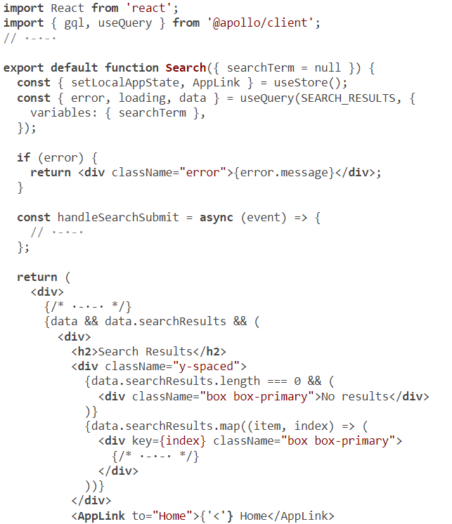

Performing operations conditionally
Notes:
Let’s convert the Search component code to use Apollo hooks. There is a new challenge: the query has to be sent conditionally only when the component has a value in the searchTerm prop. How do we make that work with useQuery?
If we just replace the query function with a useQuery hook and get rid of the useEffect hook, the code will look like this.

Slide 32
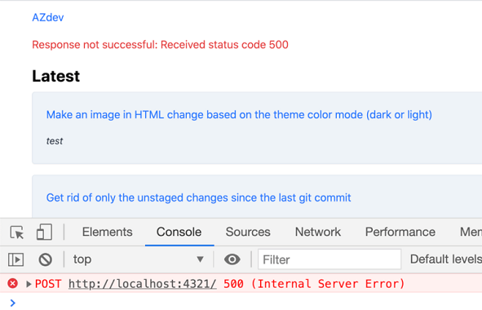
Performing operations conditionally
Notes:
Previous code will send the query operation request with a null value for searchTerm every time this component renders (figure). This component renders as part of the home page (to display the search form). So yeah, that will not work.
Unfortunately, we cannot put the useQuery call in an if statement. That’s a React requirement for using hooks (see az.dev/rules-of-hooks).
We can solve this problem in a few different ways, which we’ll explore next.

Slide 33
Performing operations conditionally
import React from 'react';
import { gql, useQuery } from '@apollo/client';
// ·-·-·
export default function Search({ searchTerm = null }) {
const { setLocalAppState, AppLink } = useStore();
const { error, loading, data } = useQuery(SEARCH_RESULTS, {
variables: { searchTerm },
skip: !searchTerm,
});
// ·-·-·
}
Notes:
Using the skip option
Apollo’s useQuery method supports a skip Boolean option. A true skip value makes Apollo not send the query operation. That’s exactly what we need.

Slide 34
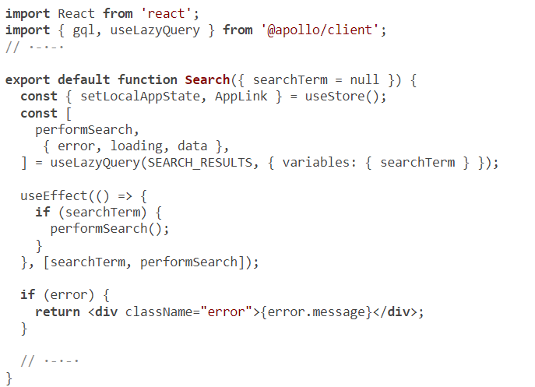
Notes:
Using a lazy query
Apollo Client has a useLazyQuery method that does not perform the query right away but rather gives you a function to perform the query (similar to how useMutation works). This means we can keep the useEffect hook function and invoke the lazy query function in it.
I like this solution a little bit better than the first one. I think it’s more flexible and easier to work with. However, these solutions (and the original code) are not ideal. I designed them that way to show you the powerful features of Apollo Client; but if you find yourself needing to use a lazy query or skip a query, I would like you to first ask yourself if the problem can be fixed by reorganizing your components using the single-responsibility principle (or other clean code principles).

Slide 35
Table of Contents
Using Apollo Client with JavaScript
Using Apollo Client with React
Managing local app state
Implementing and using GraphQL subscriptions

Slide 36
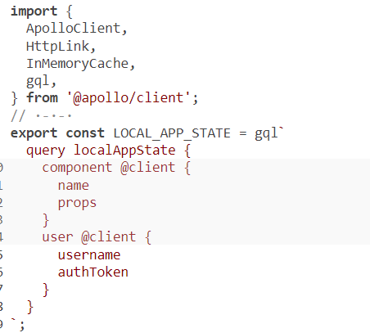
Managing local app state
Notes:
One of my favorite Apollo Client features is how it can be used to manage the local app state of an application. The word local here does not mean local to a single component. It’s a label for the state data that is not associated with remote data.
We have already been using Apollo to manage the app state. The difference about the local app state we are going to implement in this section is that it will not be associated with a server (remote) query. Instead, it will be associated with a local query, as we will see soon.
In the AZdev application, we have two local app state elements: the current user and component objects. The entire context object in web/src/store.js is there to manage these two elements. Let’s see how Apollo Client can help us get rid of that context object.
TIP
The current local app state in the app is managed with a useState call in web/src/store.js. The new state will be managed externally to the React application. When the state is managed externally, React components that need to use that state have to subscribe to it (to be notified when the external state is changed). The useQuery method is a form of subscribing since it will cause a React component function to render when the Apollo cache store has any new data for that query.
The local app state management in Apollo uses the writeQuery method to put local app state element values in the cache. However, writeQuery needs a query, and the local app state has no such query. In Apollo, we just make up a fake query for it.
You can come up with any GraphQL query (regardless of the server schema) and tell Apollo that you’d like to use that query only on the client side. You can do that for a whole query or part of an existing query. You put the @client directive on any field in a query to tell Apollo that it’s a client-only field that does not need to be fetched from the server.
So, let’s do that for the user and component local state elements. Here’s the query I made up for them. Put this in web/src/store.js.
Because all the fields in this query have the @client directive, Apollo will not send this entire query to the server. When we use the query in the app, Apollo will read it directly from the cache.
Note that I matched the structure the app uses for these elements in their made-up local app state query. This will keep the changes in the app to a minimum.
TIP
I like to keep local queries separate from the normal, remote queries. However, you can mix client-only fields with normal fields, and Apollo will split your mixed query, manage the local part locally, and send the remote part to the server.

Slide 37
Managing local app state
Now we can use Apollo to read and update the query.
For example, in places where we previously used state.user in the store, we can now read it from the cache.
const { user } = cache.readQuery({ query: LOCAL_APP_STATE });

Slide 38
Managing local app state
To update the user/component objects, instead of the current setState calls in the store, we can do the following.
cache.writeQuery({
query: LOCAL_APP_STATE,
data: { ...currentState, ...newState },
})
Notes:
Since the local app state will be managed entirely with the client instance object, that object is now the new store of the application. We don’t need the useStoreObject function (or its useStore hook). We can just define all functions as top-level exports and import them directly in components. This includes the authLink function, which we previously put inside useStoreObject so that it can access the current user authToken.
To make things a bit more interesting, let’s keep the code in all React components as is and try to replace React’s context-based local app state management with Apollo Client local app state management. This means we can only change the starting-point file (web/src/index.js) and the store file (web/src/store.js).
Let’s begin with the Provider components. We can get rid of the StoreProvider context; we don’t need it anymore. Let’s also move the client initialization code to the project starting file and leave only local app state management in web/src/store.js. This way, the local app state methods can be extracted and used across different projects and with different client instances (instead of relying on the same scope client instance).

Slide 39
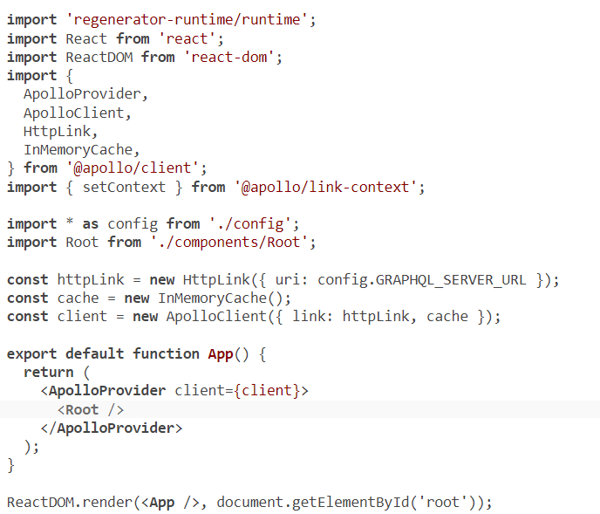
Managing local app state
Notes:
Here’s the first step in converting the code in web/src/index.js.
I didn’t do anything new here yet. I just moved a few things around and got rid of the StoreProvider and useStore calls. The interesting part is how to define the authLink function that causes the headers to include the authToken of a logged-in user.

Slide 40
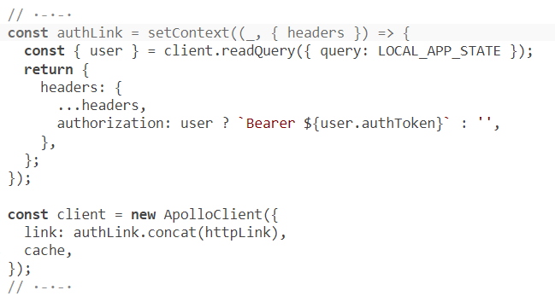

Managing local app state
Notes:
The authLink function previously accessed the state.user object directly. Now it can read that state out of the Apollo cache.
Note that we no longer need to use the setLink method since the authLink function no longer depends on another function scope. We can define the Apollo client object directly with the link chain.

Slide 41
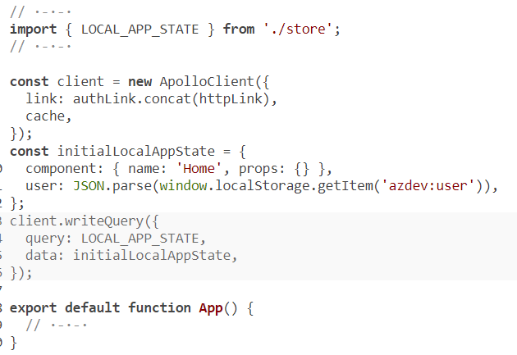
Managing local app state
Notes:
The last change we need to make in this file is to initialize the local app state. That was previously done in useStoreObject, but now we can use a writeQuery call.
Now, what remains to be changed in web/src/store.js are the three functions that work with the local app state: useLocalAppState, setLocalAppState, and the AppLink component. We’ll keep these three functions in a useStore function so that we don’t need to make any changes in the React components.

Slide 42
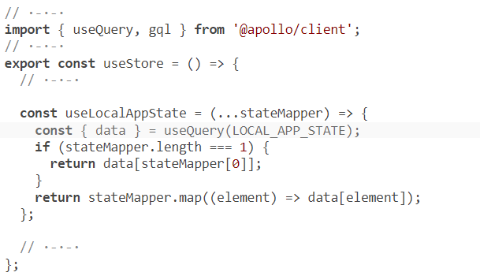
Managing local app state
Notes:
Let’s go through these three functions one at a time, starting with useLocalAppState. Here is its new implementation.
We just read the LOCAL_APP_STATE data with the useQuery hook function. That query’s data becomes the local app state.

Slide 43
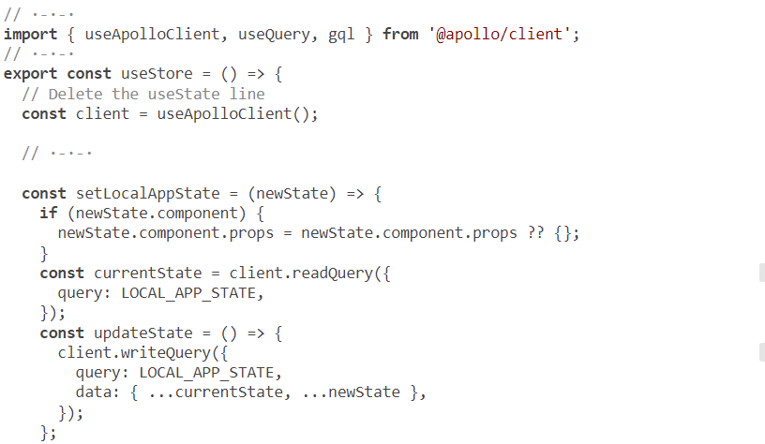
Managing local app state
Notes:
The setLocalAppState method is a bit more complicated. It needs to read and write to the cache and reset it when the user logs in or out, but without losing the new local app state (which now needs to go on that cache).
Here’s one way to implement that.

Slide 44
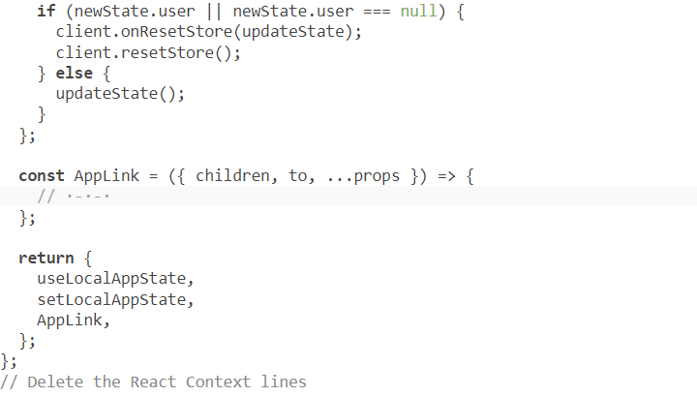
Continued code
Notes:
The setLocalAppState method is a bit more complicated. It needs to read and write to the cache and reset it when the user logs in or out, but without losing the new local app state (which now needs to go on that cache).
Here’s one way to implement that.
That’s it. All the UIs work exactly the same with these changes, but now we do all the local app state management through the Apollo Client. This is simpler than what we had before. We no longer manage a context object or any custom hooks to access it.
TIP
I use the readQuery method where I need to read the data just once (and not subscribe to it). However, in React components, the useQuery hook function should be used to read the local app state. With useQuery, components will be rerendered when the local app state changes. This is why I made the useLocalAppState function use the useQuery hook function; because of that, components that use this function will be rerendered when the local app state changes.
I hope this little example demonstrated how powerful Apollo local app state management is, but we have barely scratched the surface. There is a lot more.
For bigger local state trees, you can write custom resolvers for your local app state elements. You can also define local mutations and use them with the useMutation methods instead of doing direct writes. Another thing you get with custom resolvers is data type validation (because you define the types for arguments and input).

Slide 45
Table of Contents
Using Apollo Client with JavaScript
Using Apollo Client with React
Managing local app state
Implementing and using GraphQL subscriptions

Slide 46

Implementing and using GraphQL subscriptions
export default function Home() {
const { error, loading, data } = useQuery(TASK_MAIN_LIST, {
pollInterval: 5000,
});
// ·-·-·
}
Notes:
I saved the best for last! Let’s take a look at how to define and use GraphQL subscriptions.
Subscriptions are extremely useful when you need your UIs to autoupdate. For example, while looking at the list of Tasks on the home page, we planned to notify the user when new Task records are available-just like the way Twitter notifies you when there are new tweets on your timeline.
Polling and refetching
To implement such a feature, you have two options:
Make your app continuously ask the server about the list of Tasks.
Make your app tell the server that it is interested in new Tasks and would like to be notified when they are created.
The second option is what GraphQL subscriptions can help you do. The first option is known as continuous polling, and sometimes it is good enough: if the object you’re autoupdating is small and you don’t need real-time updates, polling is an option to consider.
Apollo makes continuous polling easy. You add just one option to the useQuery second argument to make it repeatedly poll data. For example, we can update the list of Task records on the home page every five seconds using the following simple change.

Slide 47
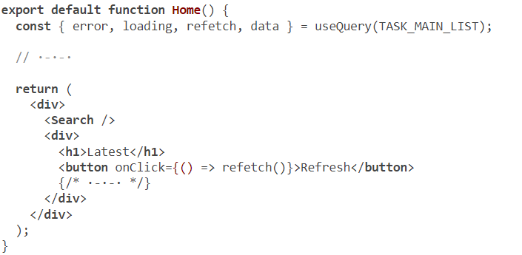
Implementing and using GraphQL subscriptions
Notes:
That’s it! Now the list will be autoupdated every five seconds.
TIP
Test this by opening two browsers and creating a Task record in one while looking at the home page in the other.
In some cases, you can do the refetching manually instead of automatically in a polling loop. If you want Apollo to fetch the query again on demand (for example, when the user clicks a Refresh button), you can use the refetch function, which Apollo makes available to all useQuery results. Here’s an example.
This code makes Apollo fetch the same query again when the user clicks the Refresh button.
These options inefficiently fetch the entire list of the latest Task records. GraphQL subscriptions are a much more efficient option for getting new data from an API server. Undo all the polling/refetching changes, and let’s autoupdate this list with a subscription operation.

Slide 48
Implementing subscriptions
Start by installing the apollo-server package.
$ npm install apollo-server
Notes:
In lesson 4, we planned two subscription operations for the AZdev API: the taskMainListChanged subscription to notify the user that new Task records are available and the voteChanged subscription to autoupdate vote counts on the Task page. However, before we start implementing them, we need to revise the API server and make it support WebSockets.
GraphQL subscriptions for web apps are usually done over the WebSockets communication protocol. A WebSocket provides a full-duplex communication channel (over a single TCP connection). The server opens the socket, and the browser connects to it and keeps the connection active. Servers can then use that active connection to push new data to the browser on demand.
The Express-based GraphQL server that we have used so far has no support for WebSockets. We need to run a new server (on a different port) for all subscription operations. There are many options for web servers that support a WebSocket transport layer designed for GraphQL subscriptions, but the most popular is Apollo Server (az.dev/apollo-server).
TIP
Apollo Server has many cool features, and it can completely replace our current Express-based server. Let’s first see how to use its WebSocket support. When we’re finished with the subscription example, we will get rid of the Express-based server and use Apollo Server as our main GraphQL API server.

Slide 49
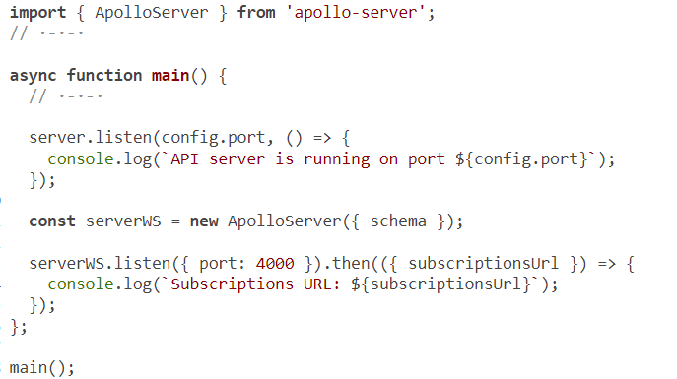
Implementing subscriptions
Notes:
make the following changes to api/src/server.js to create an Apollo server instance that works with our schema.
This will run a web-socket server on port 4000.
NOTE
Keep the Express-based server running on port 4321 for now. It is still the main web server for the API service.
The implementation of subscription operations relies on the Pub/Sub pattern (short for Publish/Subscribe). Pub/Sub is a simple messaging pattern designed to decouple data events from services that are interested in them. You can label any change to data in your code with an event label. For example, when a new Task record is created, we can have the code publish an event; and when a vote count on any Approach record is changed, we can have the code publish another event.

Slide 50
Implementing subscriptions
The Pub/Sub operations will happen in multiple places, let’s create a new file under api/src/pubsub.js to prepare a PubSub instance for any part of the API server code to use.
import { PubSub } from 'apollo-server';
const pubsub = new PubSub();
export { pubsub };
Notes:
Apollo server has a built-in PubSub implementation that we can use to do exactly that.
Now, let’s publish events in the mutations related to the subscriptions we’re implementing. We can use a pubsub.publish call to do that. We can include data as part of any published event, and that data can be used to make the subscription resolvers aware of the new mutation data.

Slide 51
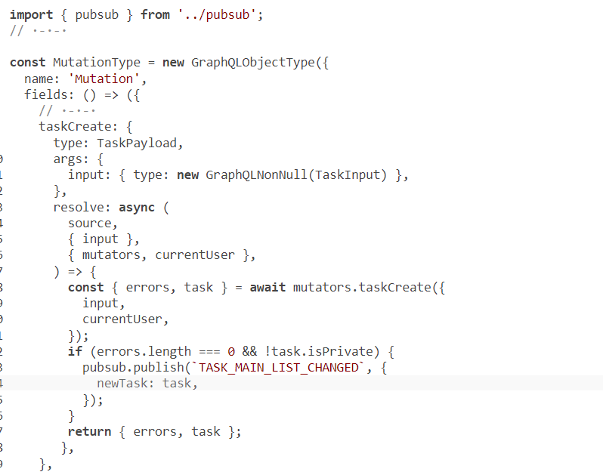
Implementing subscriptions
Notes:
We need to publish two events: one in the taskCreate mutation field to be used by the taskMainListChanged subscription, and one in the approachVote mutation field to be used by the voteChanged subscription. Here are the changes in api/src/schema/ mutations.js to publish these events.

Slide 52
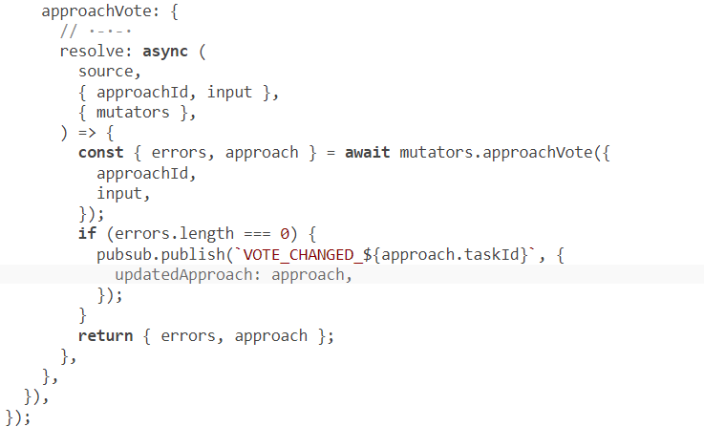

Continued code
Notes:
You can give your event labels any names you want. I like to make them match the subscription operations they serve.
Any part of the API server code can subscribe to the events being published and, for example, send their payload data over a WebSocket. That’s exactly what a field under the Subscription type can now do.

Slide 53
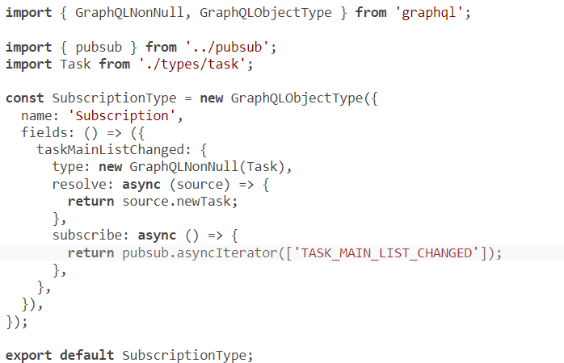
Implementing subscriptions
Notes:
Let’s first look at the taskMainListChanged subscription. Here’s one way to define it.

Slide 54
Implementing subscriptions
// ·-·-·
import SubscriptionType from './subscriptions';
export const schema = new GraphQLSchema({
query: QueryType,
mutation: MutationType,
subscription: SubscriptionType,
});
console.log(printSchema(schema));
Notes:
To make this new subscription field available in the schema, we have to make it part of the GraphQLSchema object we defined in api/src/schema/index.js.
We can now test the taskMainListChanged subscription field. However, to do that, we need a consumer that also supports WebSockets. You send the subscription operation to establish the connection and then send a mutation operation to trigger the event and see the data reported back by the WebSocket.
An Apollo server instance will make the GraphQL Playground editor available at /graphql by default (in the development environment). GraphQL Playground is a GraphiQL-based editor that supports WebSockets and has many more cool features.

Slide 55
Implementing subscriptions
To test the taskMainListChanged mutation, open the GraphQL Playground editor at http://localhost:4000/graphql and run the following operation.
subscription {
taskMainListChanged {
id
content
}
}

Slide 56
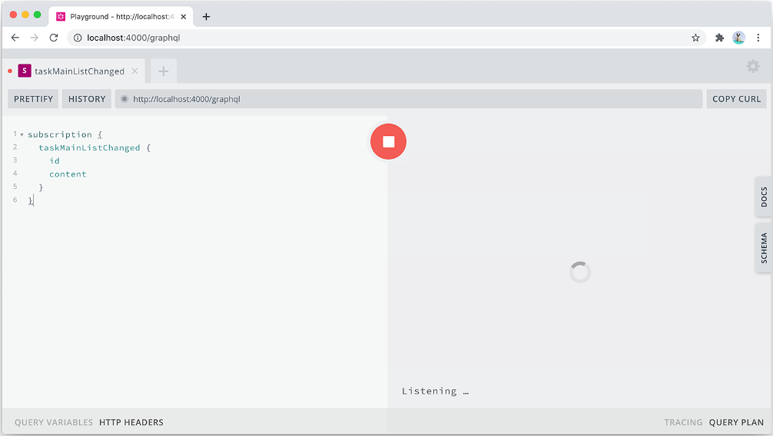
Implementing subscriptions
we can use the following Docker command to start the container and run tests:
Notes:
You’ll notice that no data is returned initially. Instead, the GraphQL Playground displays a “Listening” message reflecting the status of this subscription field resolver function, which is listening for any Pub/Sub events

Slide 57
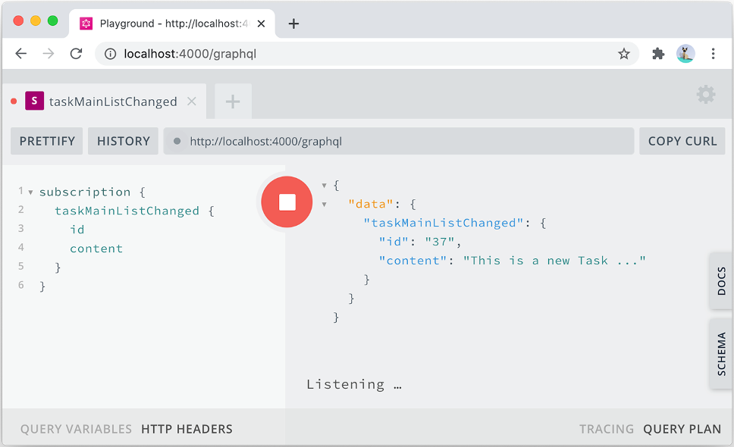
Notes:
To trigger a Pub/Sub event publish action, open the UI app in a different browser session, log in, and create a test public Task record. The GraphQL Playground should instantly show the new Task object you create in the subscription’s data response (and it will continue listening after that). Each time you create a new public Task record, it will appear in the response data

Slide 58
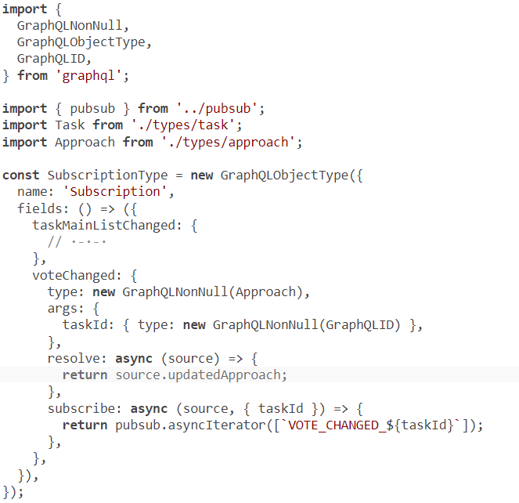
Implementing subscriptions
Notes:
How about you try to implement the voteChanged subscription field on your own first? We’ve already added the publish event for it. You just need to make changes in api/src/schema/subscriptions.js. The only difference in this subscription field is that it receives a taskId argument, so it only subscribes to the events published for one Task object. Here’s how I implemented it.
Make sure this subscription works as well in the GraphQL Playground (while voting on Approaches under a Task).

Slide 59
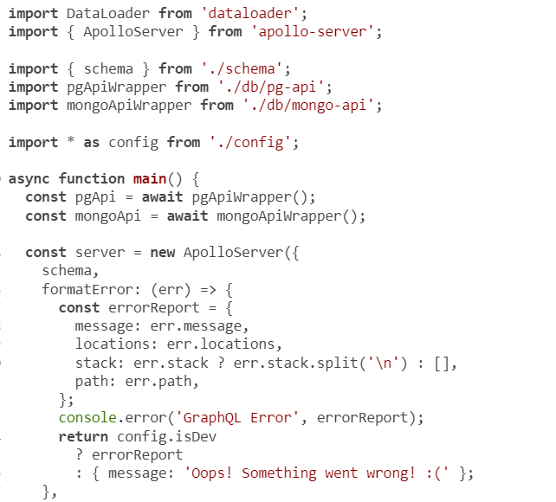
Apollo Server
Notes:
WebSocket support is just one of the many features the apollo-server package has to offer. Apollo Server can actually replace many of the packages we’re using server-side. It can replace GraphQL.js itself, and it supports implementing your GraphQL schema using only the SDL text (and not using objects). And as mentioned earlier, it can replace our entire Express-based server setup (everything related to Express).
TIP
If you’re interested in learning about implementing a GraphQL service using strings instead of objects, you can find an article I wrote on that topic at az.dev/schema-first.
To replace Express with Apollo, we have to move things around a bit. We have to define the context property as a function. Apollo makes the req object available in the argument of that function. This means we can define our loaders and mutators (which depend on the req object) right in that context function.
Here’s the new web/src/server.js file after I removed everything related to Express.js (and express-graphql) and modified ApolloServer to work with our context object.

Slide 60
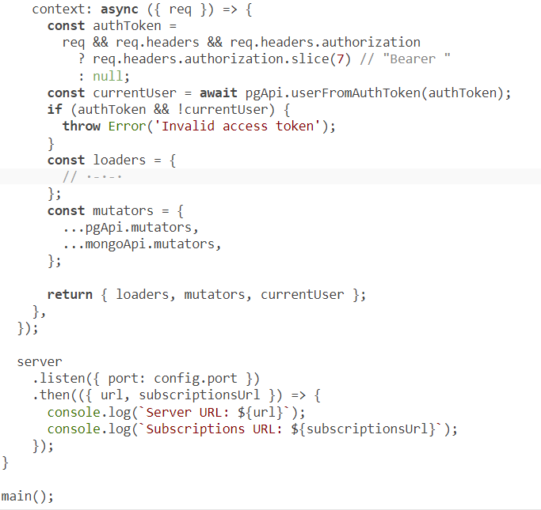
Continued CODE
Notes:
This is a lot simpler. All the code related to accepting data in the request, parsing it, and then executing the GraphQL schema against that request has been deleted. That functionality is now done internally in Apollo Server.

Slide 61
Implementing subscriptions
Note that I got rid of the 4000 port and used the default config port (which is 4321).
The new URLs are as follows:
Server URL: http://localhost:4321/
Subscriptions URL: ws://localhost:4321/graphql

Slide 62
Using subscriptions in UIs
import { WebSocketLink } from "@apollo/client/link/ws";
const wsLink = new WebSocketLink({
uri: GRAPHQL_SUBSCRIPTIONS_URL,
options: { reconnect: true },
});
Notes:
With all the subscription operations ready server-side, let’s now talk about how to use them in a React application with Apollo Client.
Apollo Client has a WebSocketLink object that can be used to do WebSocket communication in the browser. It’s designed to work with GraphQL subscriptions. To initialize it, you just give it the GraphQL subscription uri and an options object.

Slide 63
Using subscriptions in UIs
Let’s define the new GRAPHQL_SUBSCRIPTIONS_URL config value for this project.
export const GRAPHQL_SERVER_URL =
process.env.GRAPHQL_SERVER_URL || 'http://localhost:4321';
export const GRAPHQL_SUBSCRIPTIONS_URL =
process.env.GRAPHQL_SUBSCRIPTIONS_URL || `ws://localhost:4321/graphql`;
Notes:
With a WebSocketLink instance, we have two main links for Apollo Client to use: one to use with regular HTTP requests (httpLink) and another to use for WebSocket requests (wsLink).

Slide 64
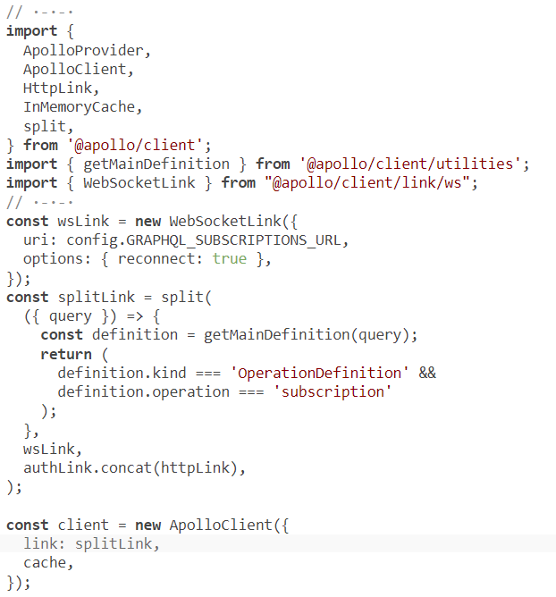
Using subscriptions in UIs
Notes:
Instead of making two different client objects for them, Apollo supports a split function that can determine which link object to use based on what GraphQL operation is being invoked.
Apollo Client will invoke this new split function for each GraphQL operation it needs to send over the wire. If the operation is a subscription, the split function tells Apollo Client to use wsLink. Otherwise, it tells Apollo Client to use httpLink. This enables us to work with only one client instance everywhere in the app.

Slide 65
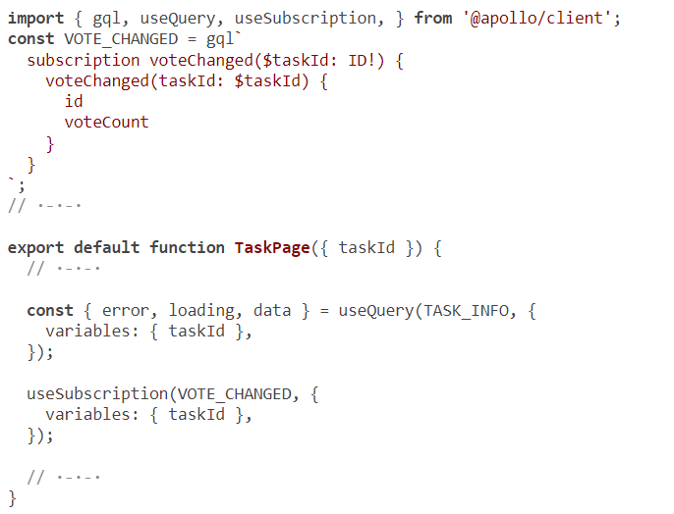
Using subscriptions in UIs
Notes:
That’s all the setup work required to make Apollo Client ready for subscriptions. To make a React component use a subscription operation, we just invoke the useSubscription hook function. For example, here’s the code to make the vote counts on Approach objects update in real time.
That’s it. You can test this with two browsers open on the same Task page and vote up/down on any Approach in one browser. The other browser will update in real time!
Under the hood, Apollo takes care of figuring out that this subscription is bringing updates related to an Approach record on this page. The useQuery results are auto-refreshed, causing the TaskPage component to rerender with the new vote.
Try to use the taskMainListChanged subscription on your own. The changes go in the Home component (web/src/components/Home.js). To keep things simple, when a new Task is fetched through the subscription, insert it at the top of the list and highlight it differently. I’ve put my solution in the next (and final!) Git branch.

Slide 66
Summary
A GraphQL client library like Apollo manages all the communications between a frontend application and its GraphQL API service.
It issues data requests and makes their data responses available where needed.
You can use Apollo Client with plain JavaScript or with view libraries like React, Vue, and Angular.
For React, Apollo Client provides custom hook functions that greatly simplify the code in function components.
Notes:
Apollo has a powerful caching store that’s designed to work with GraphQL’s graph-like structure. The cache works automatically in common cases, but you can also manually read it and modify it. This cache, combined with other features in Apollo, can replace local app state management tools (like React’s context or Redux).
Apollo Client is flexible. It offers many methods to invoke queries on render, on demand, or conditionally. You can use different types of caching stores. You can modify request headers globally or per operation. You can skip queries and instruct Apollo not to cache them if needed. You can have it communicate with multiple GraphQL services and use the same store for them. You can even use it to communicate with REST-based API services.
GraphQL subscriptions are great for incremental real-time data. To use subscription operations in web applications, a GraphQL server has to support WebSockets and a Pub/Sub messaging pattern. Apollo Server is an example of a GraphQL implementation that has that support. On the frontend, a client has to determine what communication channel to use based on the operation and use a WebSocket-based link for subscriptions.

Slide 67

"Complete Lab"

